Slide 1
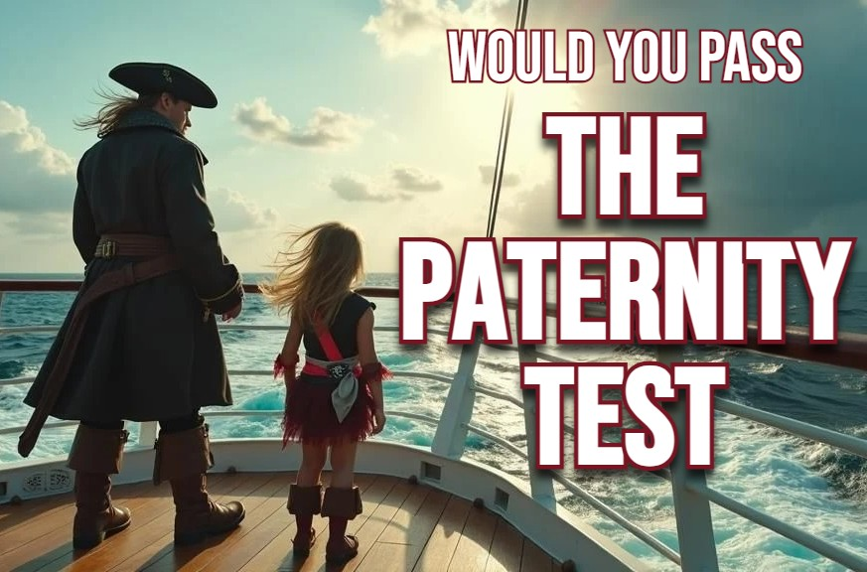
“There’s still one place on earth – where chivalry isn’t dead”

Slide 2
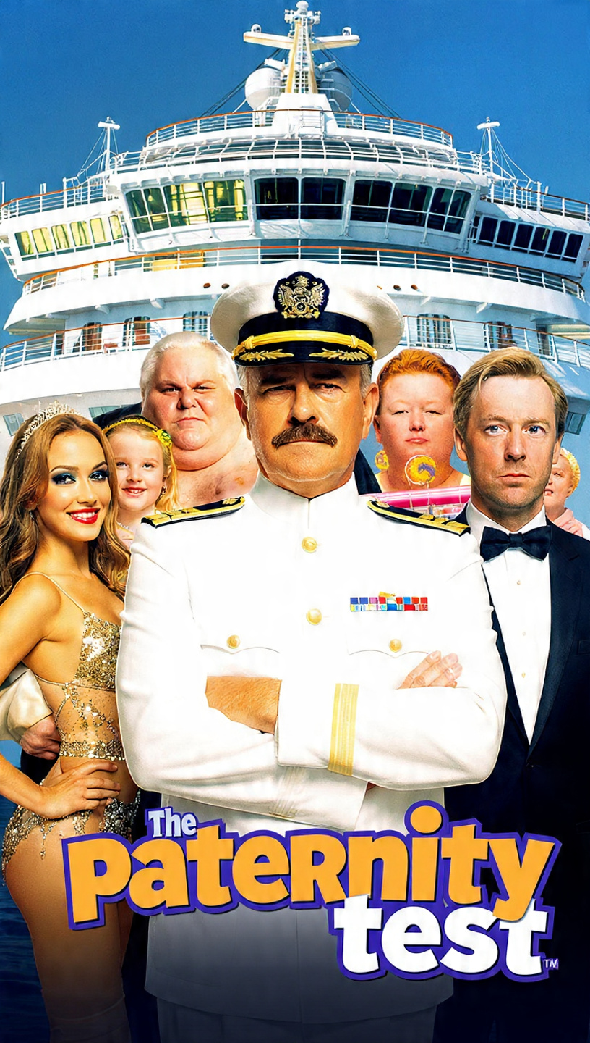

two Comedic Thrillers by JD Moorea
“When fatherhood, fame, & felony collide on the high seas”

Slide 3

LOGLINE
“A washed-up musician risks losing his family & freedom when a box of drugs and a young stowaway turn up in his cabin on his first day working at sea”
“A washed-up musician gets a second chance at fatherhood when a stowaway chooses him.”

Slide 4
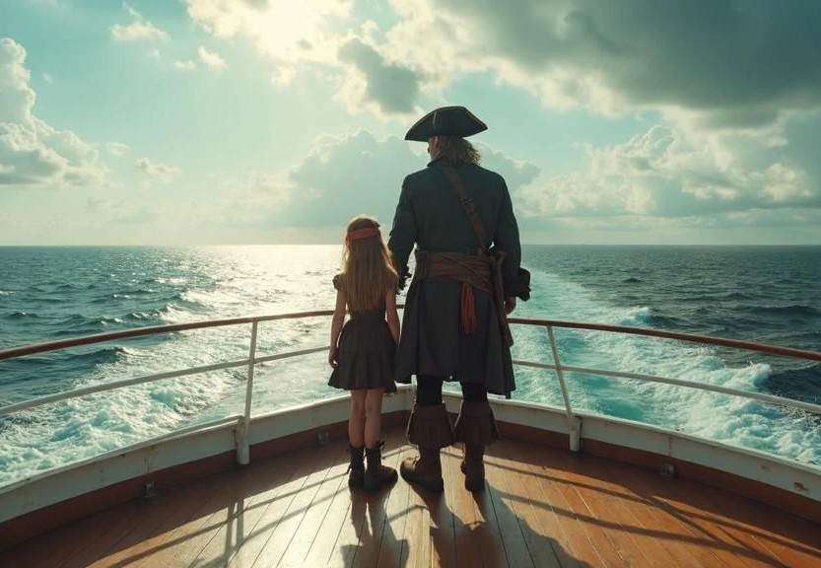

genre:
comedic-thriller / character driven
comparables:
“the love boat” meets “the hangover ii”
The Paternity Test blends sharp humor, high-stakes tension, and emotional redemption with the moral gravity of Catch Me If You Can.
Where:
the world’s most advanced cruise ship in the gulf of thailand
Hook:
“He came to fix his life; but he stayed to save theirs”
QUESTION:
Have you ever blamed your parents for how messed your life was, despite you being a huge success?

Slide 5
SYNOPSIS
Klint Maxwell, a once-promising music prodigy now reduced to teaching prep-school music, hits rock bottom after a messy divorce. His wife hates him, and his daughter can’t stand him. In a drunken attempt to hit reset on his life, Klint signs on as the Music Director aboard a luxury cruise ship—only to discover that life at sea is far from anything he saw on “The love boat”
Life onboard looks promising (for the first 12 hours) until klint wakes up on his first morning on board with a mysterious young Thai girl in his cabin, clutching a box of drug-laced lollipops and he has no memory of how either of them got there.
Not knowing who he can trust, and facing life in a thai prison if either the girl or the drugs are found, Klint must find a way to unravel the intricate web of politics on board, while keeping both Isabella (girl) and the lollipops hidden from everyone else.
Adding to Klint’s upheaval, Becky, the sexually pure daughter of the captain captures the attention of Klint and before he knows it, he is in way over his head in every way possible. As Klint and his mischievous sidekick Slim, the ship’s fast-talking sound-tech, try to uncover what each of the different colored lollipops contains, and who’s behind the smuggling of the
drugs, suspicion falls on Errol, a slick but predatory male singer with a dark secret.
With time running out and the chance of Klint’s onboard secrets being exposed, he must hatch a cunning plan to extricate both the drugs and Isabella from the ship undetected, but when Klint’s ex-wife Mandy and his daughter Hannah surprise Klint with an impromptu cruise and a heart-felt confession, everything unravels for klint.
When Klint and Slim uncover a sinister plot whereby Errol plans to deflower Becky using one of the drug-laced lollipops, Klint risks everything to save her, leading to a tense and emotional climax backstage where the unlikely hero and his stowaway expose the truth, but even their best laid plans and slim’s unrivalled knowledge of the ship is no guarantee for success.
Along the way, Klint rediscovers that the true test of fatherhood isn’t DNA — it’s doing whatever it takes, to protect those who matter most.

Slide 6
Key plot points
A former music prodigy (klint) loses his family and spirals into depression.
He is sacked from his low paying job as a prep-school teacher.
A cruise ship musical director is jailed in Thailand for possible drug trafficking.
Klint stumbles into a cruise ship job, but not all is as he hoped it would be.
Klint wakes up with a mysterious box of lollipops and a stowaway in his cabin.
A power struggle develops between the music director & the singer, but is there more to it?
Slim & klint begin to uncover that each lollipop has a different effect.
The illicit trade of lollipops onboard is rife with crew desperate to get their “fix”
Klint begins to fall in love with Becky but thinks she is dating the captain.
Klint tries to smuggle Isabella off the ship but discovers she has no family to go to.
Mandy (klint’s ex) boards the ship with his daughter, derailing his plans.
Klint & slim discover that Errol (singer) is the drug-lord / predator.
Becky becomes the target of a heinous crime.
Klint & slim must save becky, protect Isabella, & expose Errol or face life in jail.
The aftermath reveals that becky and her dad were in on the plot all along.

Slide 7
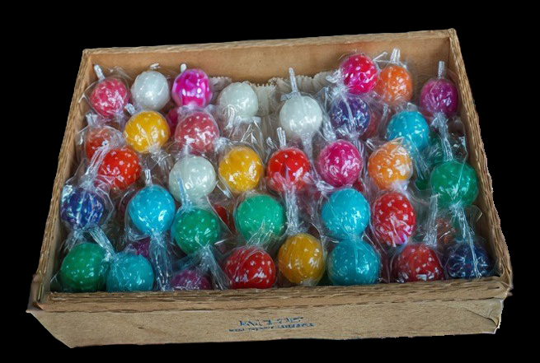
The lollipops – the key to the entire plot
The key to uncovering the sinister plot for klint lies in uncovering what each of the different colored lollipops do. Here’s the cheat sheet for those playing at home:
green – Makes you forget
Blue – Viagra
Red – speed
Orange – date rape drug
Through a process of elimination, Klint and slim slowly work things out with hilarious consequences, but the orange lollipop remains a mystery.
Most of the crew know what the red, blue and green lollipops do but only Errol knows what the orange one is for.

Slide 8


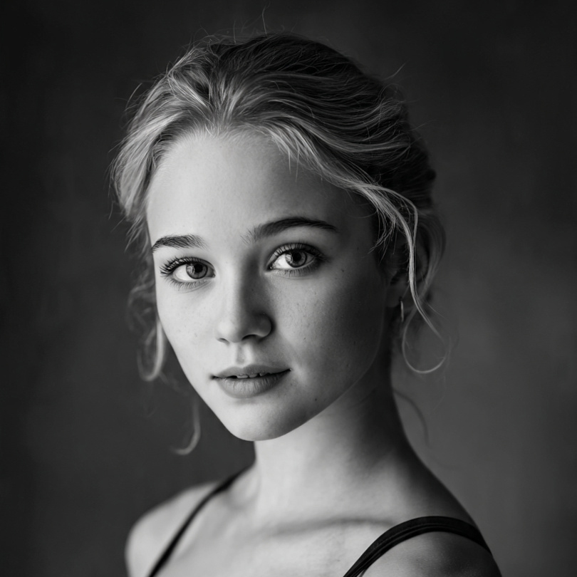

MAIN CHARACTERS
Late 20’s. A wasted genius. graduate of the Julliard school who got a one-night-stand pregnant on graduation night and spiraled into drug abuse before becoming a prep-school music teacher out of desperation. haunted by failure and a broken family. A deadbeat dad who needs to prove himself to win back his family.
Klint maxwell
Isabella aromdee
8 years old. A streetwise thai orphan who stows away aboard the ship after escaping human traffickers in Thailand. Her fearless wit and emotional intelligence melt Klint’s defenses, symbolizing the “paternity test” of his moral growth.
Becky Robinson
20’s. The ship’s charismatic Canadian lead singer. talented, sharp, and Saving herself for marriage. Raised by a single protective cruise ship captain, she is far wiser than her sweet disposition suggests. Her “innocence” makes her a prime target for predators – or does it?
Mid 30s. The eccentric, British, bleach-blonde cock-up sound technician and comic relief. Crude, quick-witted, and loyal, Slim acts as Klint’s unlikely ally. His resourcefulness and humor balance the tension, while his friendship helps steer Klint toward redemption.
Steve “slim” pulford

Slide 9




SUPPORTING CHARACTERS
Errol baker
Early 30s. The ship’s charming but sinister male singer. Beneath his fake aristocratic exterior lies a manipulative predator involved in the lollipop-drug trade. His eventual assault on Becky marks the film’s darkest turn and cements him as the story’s antagonist.
Mandy maxwell
Late 20s. Klint’s ex-wife. Polished and pragmatic, she masks her pain with control. Her reappearance onboard reignites old wounds and underscores Klint’s failures as both husband and father, while testing his sincerity in becoming a better man.
hannah maxwell
10 years old. Klint’s resourceful daughter who despite her loathing of her father, like any young girl wants her dad to be her hero. She always dreamt of having a sibling and as fate may have it, she may just get her wish in the most unlikely of ways
Mid-50s. A dignified, by-the-book Canadian captain whose moral compass hasn’t dimmed after decades at sea. His meticulous nature is both a blessing and his downfall that may lead to his daughter being placed in harms way.
Captain bill robinson

Slide 10

writer's VISION
“As a child of the 70’s and a former cruise ship singer with over 1 million miles sailed at sea, I wish to honor the romantic nature of “the love boat” while showcasing the polar opposite of what cruising is all about.
I grew up adoring the love boat in the 70’s and always wanted to become “Julie McCoy” but what I discovered was that life at sea is so much more than what any episode of the love boat could explain and this movie captures the essence of what it’s really like to be a dad and a cruise ship performer.
— JD Moorea

Slide 11
The sequel
When is a sequel not a sequel?
(When slim turns it into a debaucherous adventure)
All aboard the ship of erotic dreams as our favorite cruise hoodlum (slim) is joined by the same characters plus the new owner of the playmate mansion (Charlie sheen) along with 2 dozen of his playboy bunnies on a ten-day cruise.
Without his best friend klint around, Slim is out of control so captain robinson calls on his new son in law to return - this time as cruise director because he is the only person slim listens to.
Can klint dull slim’s vulger disrespect of the ship’s protocols, or will Charlie sheen and his playboy bunnies lead slim even deeper into uncharted waters?
Either way, what unfolds is a hilarious takedown of your long-held beliefs that cruising is all about love.
It’s like “American pie” meets “The love boat” in the 21st century

Slide 12
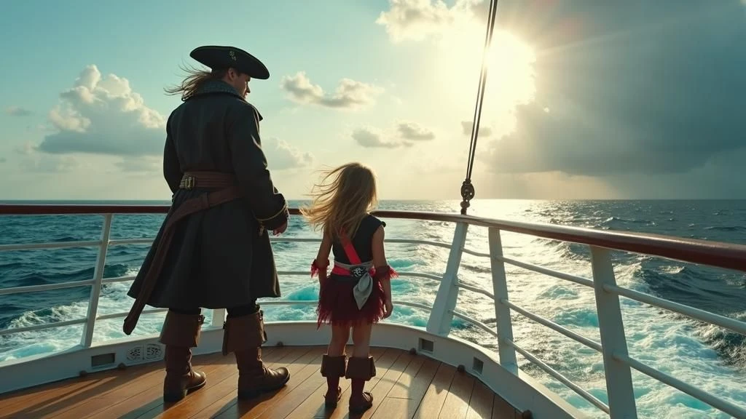
FINAL TAGLINE
“Any man can make a child - but Only a real man can protect one.”

